Slide 2
Computer Vision Track
Session 1 - Introduction to Computer Vision/Overview

Slide 3
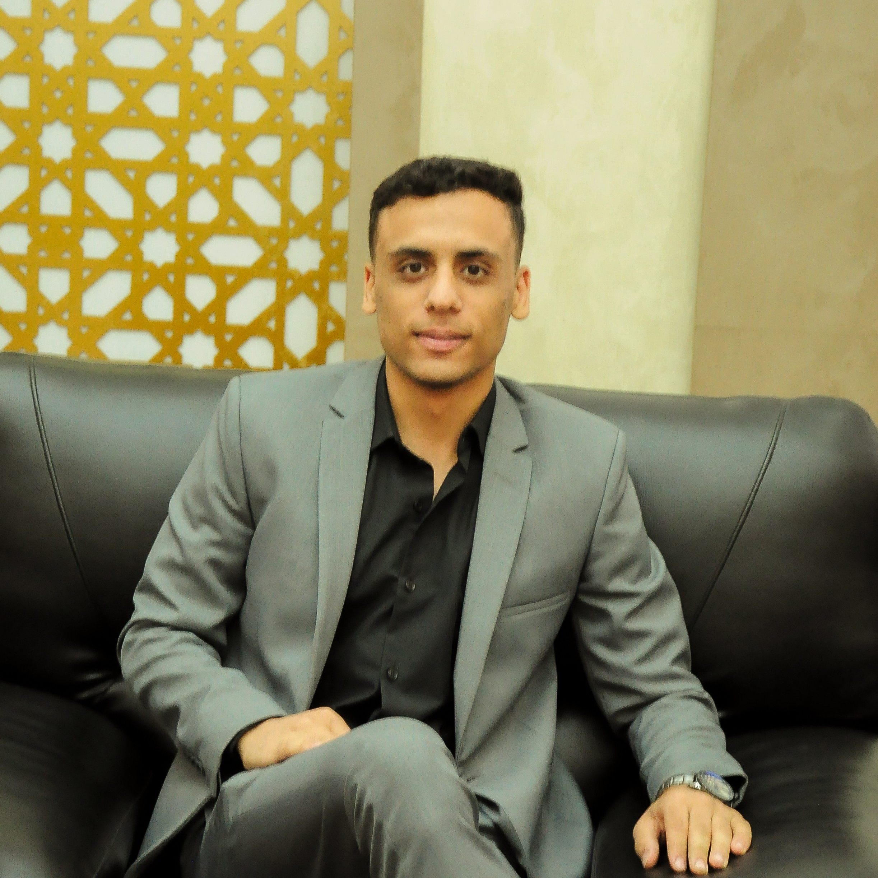
About Me
I am Ibrahim Hendawi. I live in Kafr Elsheikh. I’m a Student at the Faculty of Artificial Intelligence (Third year).

Slide 4
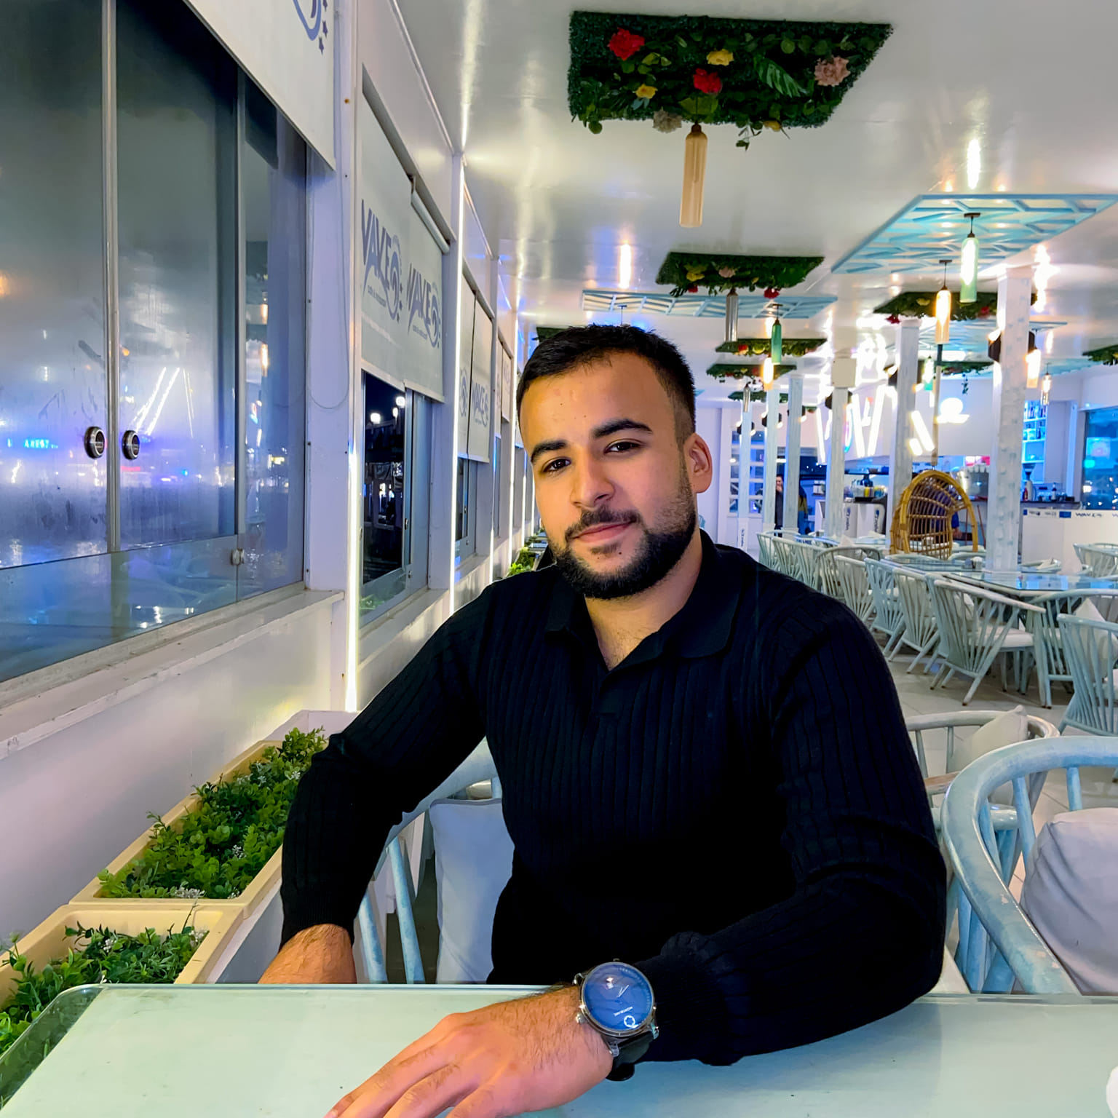
About Me
I am Youssef Khalaf. I live in Kafr Elsheikh. I’m a Student at the Faculty of Artificial Intelligence (Third year).

Slide 5
Agenda
What’s Computer Vision?
How Computer Vision Model Works
Computer Vision Tools
Learning Objectives
Recommended Background
Plan Outline

Slide 6
What’s Computer Vision?
Computer vision is an interdisciplinary scientific field that deals with
identifying and processing objects in visual inputs, such as digital
images, videos, and even text.

Slide 7
Agenda
What’s Computer Vision?
Computer Vision Tools
Learning Objectives
Recommended Background
Plan Outline
How Computer Vision Model Works

Slide 8
How Computer Vision Model Works
A lot of data is required to start.
Training on input data until the model learns to distinguish and recognize provided visual inputs.
The model thus learns to make predictions based on the training data and gradually comes to recognize objects.
The performance of the model is based on the input data and the algorithm itself.

Slide 9
Agenda
What’s Computer Vision?
How Computer Vision model Works
Learning Objectives
Recommended Background
Plan Outline
Computer Vision Tools

Slide 10







Data Science Tools

Slide 11
Agenda
What’s Computer Vision?
How Computer Vision model works
Computer Vision Tools
Recommended Background
Plan Outline
Learning Objectives

Slide 12
Learning Objectives
Understanding Core Concepts
Image Processing Fundamentals
Feature Extraction Techniques
Object Recognition and Tracking
Hands-On Experience
Implementing Algorithms in Python
Working with OpenCV Library
Developing Real-world Projects
Problem Solving and Critical Thinking

Slide 13
Agenda
What’s Computer Vision?
How Computer Vision model works
Computer Vision Tools
Learning Objectives
Plan Outline
Recommended Background

Slide 14
Recommended Background
Proficiency in Python, ideally with experience in Matplotlib and NumPy.

Slide 15
Plan Outline
1. Data Preparation
2. Model Training (CNN)
3. Deployment and Communicating Results

Slide 16
Thanks

